Slide 1


Pioneering Discoveries, Transforming Lives

Slide 2

Manovikas Kendra (MVK) is a dedicated not-for-profit institution providing rehabilitation, inclusive education and vocational training to neurodivergent children since 1974.

Slide 3



Mission
No child left behind
Vision
To explore and develop to the fullest, the potential that lies in each individual
Salmoli Chakraborty has learning difficulties, since she had asphyxia at birth. Since she joined Manovikas for NIOS and vocational training, she trained as a swimmer and received a gold medal for swimming at special Olympics in 2019

Slide 4










Leadership at Manovikas Kendra

Slide 5
External Researchers
Prof. Kiranmoy Das, ISI Kolkata (expert in Bayesian semiparametric modelling, Biomedical Statistics and Statistical Genomics)
Prof. Gopal K. Basak, ISI Kolkata (expert in Stochastic modelling, Biostatistics, Finance)

Slide 6







Centre for Assessment & Therapy
Centre For Biomedical Research and Diagnostics
Centre For Education
National Institute of Open Schooling
Centre For Vocational Training
Centre For Physiotherapy

Slide 7
Centre for Assessment & Therapy
It is the gateway for specialized care and personalized therapy programmes for individuals with special needs and mental health.
Our Multidisciplinary team of experienced Psychiatrists, Psychologists, Special Educators, Speech and Language Pathologists, Occupational Therapists and Physiotherapists work collectively to provide evidence-based interventions.

Slide 8




Centre for Education caters to the educational and functional needs of students with intellectual and developmental disorders, hearing impairments and learning disabilities through various training programmes and therapeutic interventions.
National Institute of Open Schooling is the largest open schooling system in the world. The relaxation and flexibility offered by the Open Schooling System, helps students to pursue academic courses with ease.

Slide 9
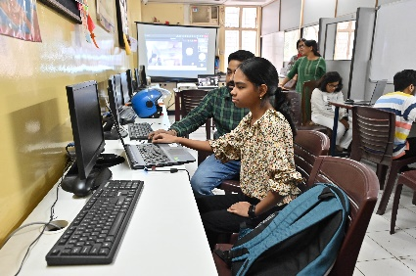





Centre For Vocational Training

Slide 10
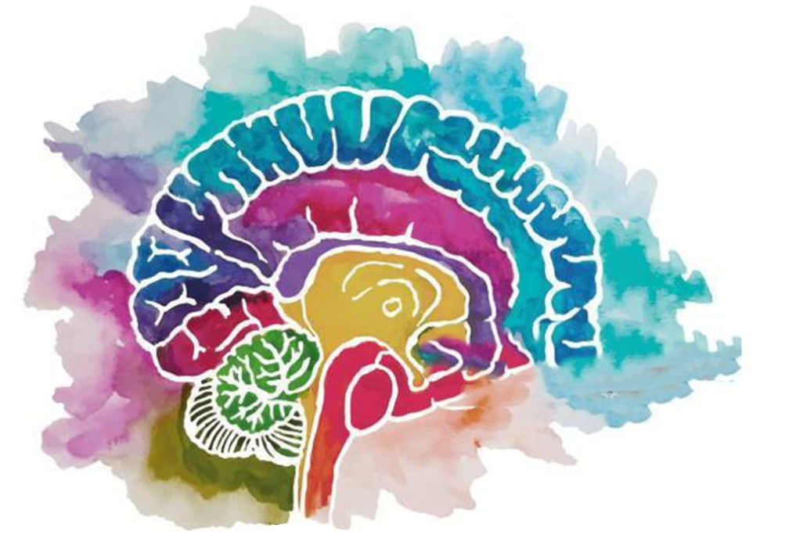
Centre for Molecular & Biomedical Research
After the clinical diagnosis, molecular biologists confirm genetic, chromosomal or proteomic abnormalities
In 1999, MVK established the Centre for Molecular and Biomedical Research, recognized by the Department of Science and Technology as a Scientific and Industrial Research Organisation (SIRO)
We work on developing molecular diagnostics, pharmacogenomics analyses and brain function therapy to deliver precise treatments and enhance rehabilitation outcomes
Created by Roshan Jha (student of MVK, NIOS, secondary) diagnosed with Specific Learning Disability (SLD)

Slide 11
Neurodevelopmental Disorders studied at Manovikas Kendra
Intellectual Disability (ID): impairment in general intellectual function, social skills and adaptive behavior
Down Syndrome (DS): developmental delays, intellectual disability, decreased or poor muscle tone and distinct facial features like a flattened face, flat nasal bridge, etc.
Autism Spectrum Disorder (ASD): low to very high IQ, poor social interaction and communication skills, presence of repetitive behavior, etc
Attention Deficit Hyperactivity Disorder (ADHD): average to high IQ, age-inappropriate inattention, hyperactivity and impulsivity
Other disorders: Klinefelter syndrome, Turner syndrome

Slide 12


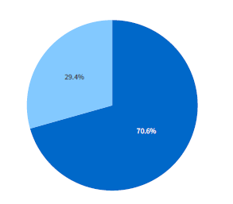

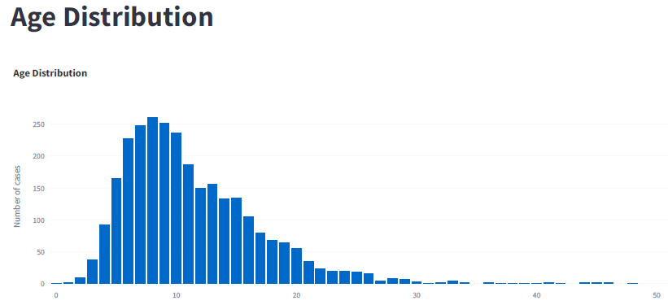
Assessment of patients using DSM-5
Autism Spectrum Disorder
Intellectual Disability
Attention Deficit Hyperactivity Disorder
Down Syndrome
Developmental Delay
250
200
150
100
50
0
Cerebral Palsy
Gender Distribution
Developmental Delay with autistic trait
Number of Cases
0 10 20 30
Age
Age Distribution of the Assessed Patients
*2130 cases diagnosed over 3 years
Notes:
Diagnostic and statistical Manual of mental disorders 5th edition American psychiatric associtaion

Slide 13



Brain Function Therapy
Mindfulness Cognitive training Neurofeedback therapy

Slide 14
Cognitive training is targeted at improving brain function through programmed mental activities to enhance one’s cognitive abilities

Slide 15
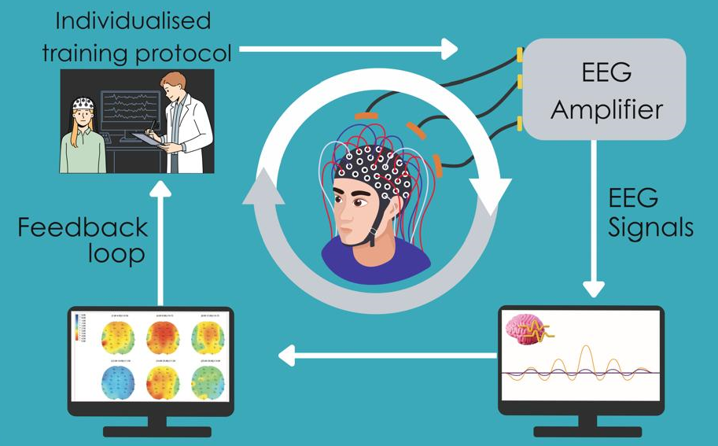
Neurofeedback is a quantitative electroencephalogram based, non-invasive therapeutic tool to improve behavioral and psychological symptoms

Slide 16
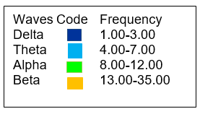
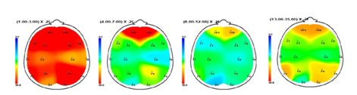
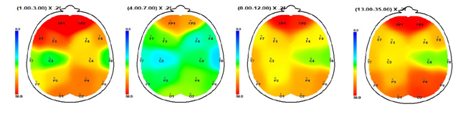
NFB improves wave patterns in neurodivergent subjects by reducing slower waves (Delta, Theta) and increasing the faster waves (Alpha, Beta)
Pre-therapy
Higher Delta and Theta waves
Higher depression and anxiety
Lower Alpha and Beta waves
Decrease in concentration, focus, mental ability
Post-therapy
Lower Delta and Theta waves
Lower depression and anxiety
Higher Alpha and Beta waves
Increase in concentration, focus, mental ability
Delta
Theta
Alpha
Beta

Slide 17
Examining the Molecular Basis of Neurodivergence
Assessment of patients by psychiatrist
Recruitment of age, sex, and ethnically matched neurotypical control
Peripheral blood sample collection
Biochemical analysis
Vitamins and metabolites
Neurotransmitter
Genotyping
mRNA expression
Cytogenetic studies
Karyotyping
Micronucleus assay

Slide 18
Autism Spectrum Disorders
Attention Deficit Hyperactivity Disorder
Age at Onset
Prevalence
Gender Bias
Assessment Tool
~3 years (CDC, 2020)
1.85% (USA) (CDC, 2020)
1.12% (India) (Panda, 2019)
Male: Female= 4:1 (CDC,2020)
Indian data not known
Childhood Autism Rating Scale –
2nd edition-standard form
(CARS-2ST) (Schopler et al., 2010)
~12 years (DSM 5, 2013; APA)
Worldwide: 5-8% (children); 2.5% (adult)
(Salari, 2023; Song, 2021)
Cases at Manovikas Kendra: 6-11% (children);
5%(adult) (Ghosh, 2018)
Male : Female
Worldwide: 2-10:1 (Joseph,2019; Ayano, 2020)
Cases at Manovikas Kendra: 10:1 (Das, 2011)
Conners Parent Rating Scale-Revised (CPRS-R)
(Conners et al., 1998)
Conners 4th Edition. Pearson Assessments
(Conners 2022)

Slide 19
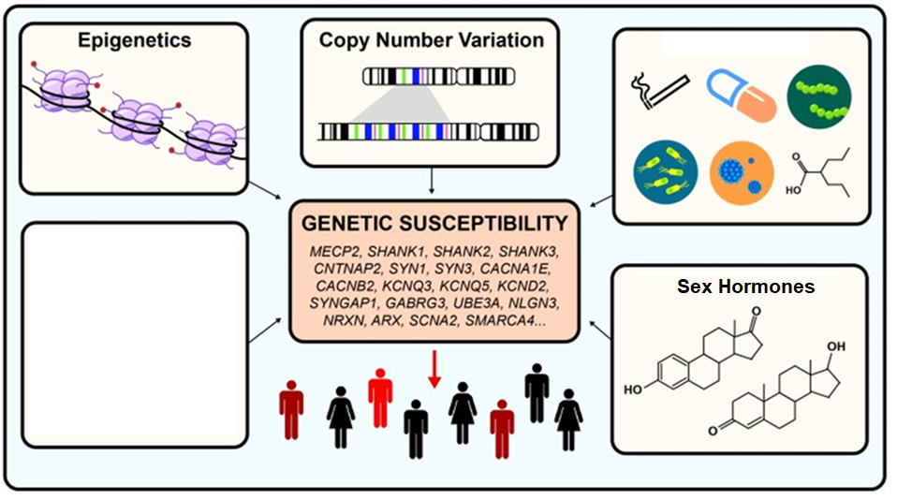
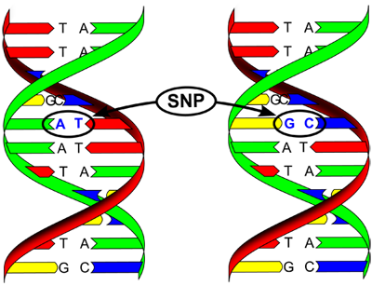
ASD and ADHD Have Complex Etiologies
Genetics & Environment
Single Nucleotide
Polymorphism

Slide 20
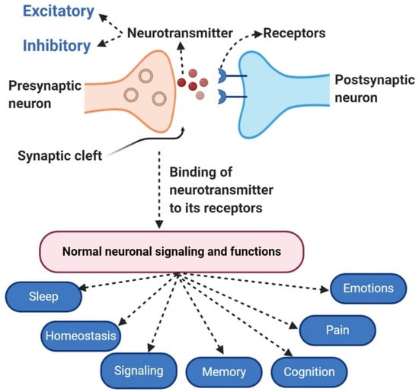
Neurotransmitters Work In Complex Networks And Systems To Regulate Human Behaviour And Physiological Function
Dopamine and serotonin can have opposing effects:
  high dopamine and low serotonin are linked to impulsivity
  low dopamine and high serotonin are linked to depression
Excitatory neurotransmitters like glutamate accelerate neuronal firing
Inhibitory neurotransmitters like GABA prevent excessive neuronal firing
The balance between excitatory and inhibitory neurotransmitter, is crucial for maintaining mental and physical health

Slide 21
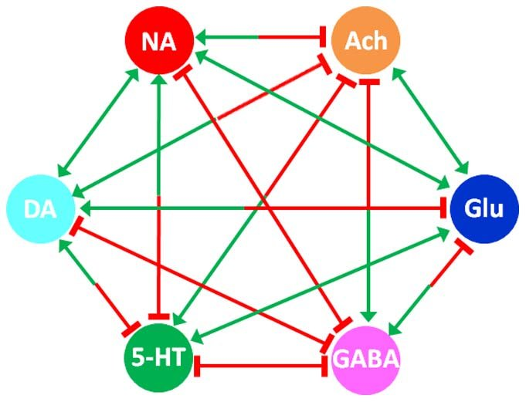
The Neurotransmitter Interaction Matrix
Arrows represent stimulation; bar-headed lines represent inhibition.
Dopamine (DA), acetylcholine (ACh), serotonin (5-HT), glutamate (Glu), noradrenaline (NA),
gamma-aminobutyric acid (GABA)
Qi, Zhen & Tretter, Felix & Voit, Eberhard. (2014). A Heuristic Model of Alcohol Dependence. PloS one. 9. e92221. 10.1371/journal.pone.0092221.

Slide 22
Identification Of Specific Biomarkers For Diagnosis And Therapy Is An Unmet Need

Slide 23
Autism Spectrum Disorder

Slide 24
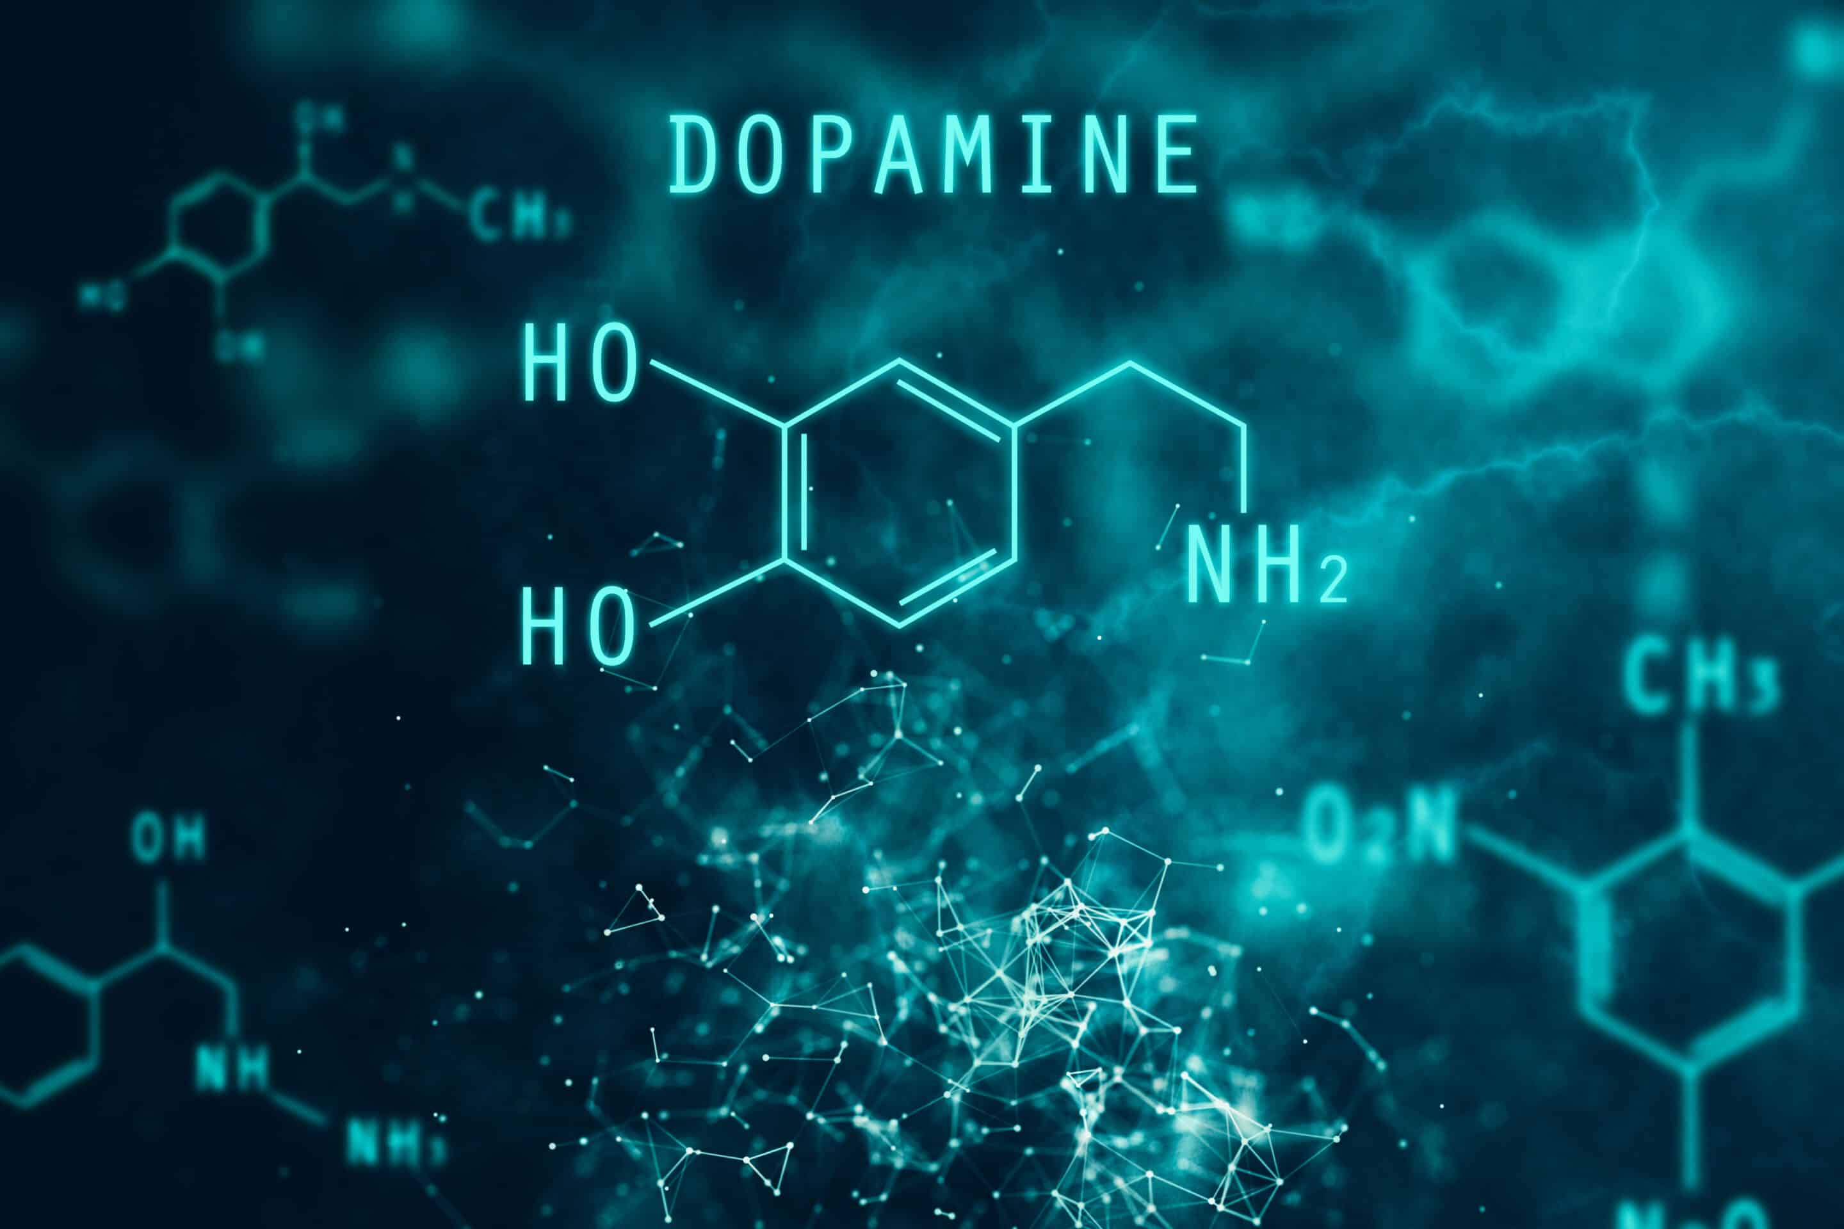
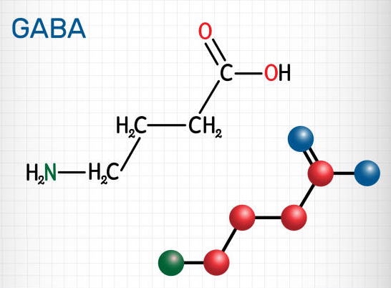
Neurotransmitters studied in ASD patients
Dopamine (DA)
Gamma-aminobutyric acid (GABA)
Neuro-modulatory chemical controlling executive functions, communicational skills and motor activity
Studies on ASD patients indicate a hypo-dopaminergic state
Regulates synchronized brain activity
Imbalanced excitatory/inhibitory neurotransmission is prevalent in ASD due hyper GABA-ergic transmission

Slide 25
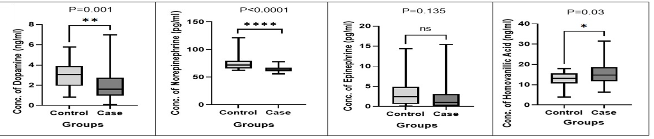
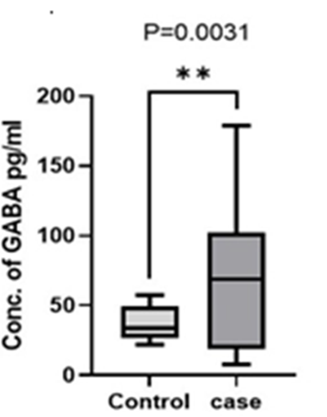
Higher GABA was associated with lower DA, NE and higher HVA levels in ASD patients
GABA
Dopamine
Norepinephrine
Epinephrine
HVA
* Norepinephrine & Epinephrine: Neurotransmitters synthesized from Dopamine
Homovanillic Acid (HVA): Major metabolite of Dopamine
Saha et al., Journal of Molecular Neuroscience, 72:1300-1312 , (2022)

Slide 26

Specific nucleotide variations showed higher frequencies in ASD patients
Dopamine transporter
GABA receptors
Gene (Marker ID) | Allele/ Genotype | Frequency |  | χ(P)
 |  | Control | ASD Patients
DAT1 (rs28363170) | 9R | 0.14 | 0.21 | 8.21 (0.004)
 | 9R/9R | 0.02 | 0.06 | 10.67 (0.005)
DAT1 (rs3836790) | 5R | 0.19 | 0.24 | 4.65 (0.03)
 | 5R/5R | 0.04 | 0.05 | 6.04 (0.05)
 | 5R/6R | 0.30 | 0.39
Gene (Marker ID) | Allele/ Genotype | Frequency |  | χ(P)
 |  | Control | ASD patients
GABRB3 rs1432007 | A | 0.60 | 0.72 | 7.87 (0.005)
 | G | 0.40 | 0.28
 | AA | 0.32 | 0.51 | 9.43 (0.008)
 | AG | 0.56 | 0.42
 | GG | 0.12 | 0.07
GABRA5 rs140682 | C | 0.45 | 0.30 | 11.67 (0.0006)
 | T | 0.55 | 0.70
 | CC | 0.19 | 0.10 | 12.69 (0.002)
 | CT | 0.53 | 0.40
 | TT | 0.28 | 0.50
Saha et al., Metabolic Brain Disease, 37:397-410 (2022);
Saha et al., Journal of Molecular Neuroscience, 72:1300-1312 (2022)
Notes:
DAT1: dopamine transporter
GABRB3: gamma-aminobutyric acid receptor subunit beta-3
GABRG3: gamma-aminobutyric acid type A receptor subunit gamma3

Slide 27
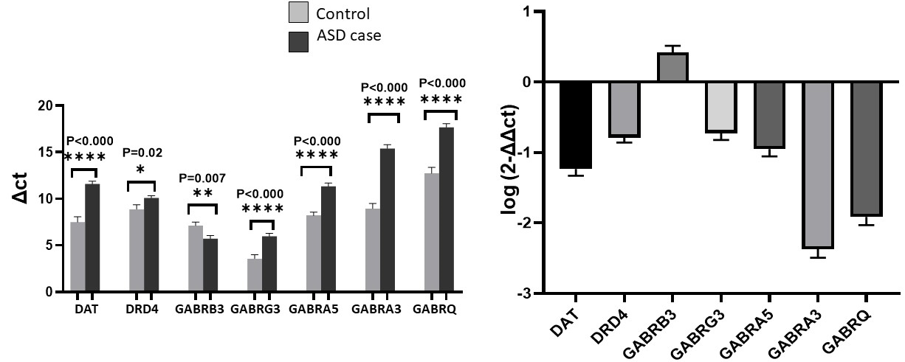
Decreased Dopaminergic and GABA receptor gene expression with the exception of GABRB3 expression was seen in ASD patients
GABA-ergic control over the dopaminergic system is hypothesized to occur through GABRB3.
GABRB3 is reported to be co-localized in dopaminergic neurons (Okada et al., J. Neurochem, 89:7-14, 2004)
GABRB3 Knockout mice were reported to attenuate ASD-associated behavioral anomalies.
(Parker et al., J. Neurosci, 31:17103-112, 2011)
Saha et al., World Journal of Pediatrics, 19:770-781, (2023)

Slide 28
Proposed Role of GABA and Dopamine in ASD
Increased GABA-ergic neurotransmission inhibits DA-ergic signalling
via the GABRB3 receptor
Hypodopaminergic state
Loss of Reward function
Behavioural Impairments

Slide 29
Serotonin imbalance is prevalent in ASD
ASD patients express higher levels of Serotonin transporter (SERT)
Increased serotonin reuptake in the platelets
Lowered amount of circulatory serotonin
Increased repetitive behaviour and irritability
Pharmacological interventions with SSRI
Normalizes extracellular serotonin availability
Reduced behavioral issues
* SSRI: Selective serotonin reuptake inhibitor
Chakraborti et al., Frontiers in Neuroscience, 13, 1375, (2020);
Jaiswal et al., Progress in Neuro-Psychopharmacology and Biological Psychiatry, 56,196, (2015)

Slide 30
Attention Deficit Hyperactivity Disorder

Slide 31
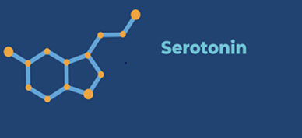
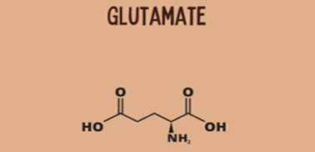
Neurotransmitters studied in ADHD
Serotonin (5-HT)
Glutamate (Glu)
Regulates mood, cognition, reward, and digestion
Higher levels cause diarrhoea, restlessness, and seizures
Lower levels lead to depression, anxiety, impulsivity, and aggression
Plays a key role in brain function, learning, memory, and mood regulation
Higher levels increase hyperactivity, impulsivity, and anxiety
Lower levels leads to depression and lack of concentration

Slide 32
Analysis of neurotransmitters, genetic traits, and pharmaceutical intervention in ADHD
Quantitative trait analysis by genotypic and phenotypic studies
Expression of key genes in neurotransmitter pathways
Case-control analysis of neurotransmitters
Familial transmission of independent genetic variants
Patient response to drug intervention

Slide 33
Patients with derived alleles of SLC6A4 & GRM7 showed higher ADHD trait scores
Inattention
Hyperactivity
ADHD Index
Inattention
ADHD Index
SLC6A4 encodes for serotonin transporter gene,
5-HTTLPR is the VNTR located in the promoter region of SLC6A4, L long repeat, S short repeat
GRM7 is a metabotropic glutamate receptor 7, rs3792452 is an intronic variant
Chatterjee et al., World Journal of Pediatrics, 18:825-834, (2022)
Chatterjee et al., Scientific Reports, 13:19922, (2023)
Notes:
For genotype-phenotype correlation analysis mean values of Connor’s Parent Rating Scale-Revised (CPRS-R) scores of ADHD probands were calculated for each genotype. CPRS-R is a diagnostic assessment tool that quantitatively rates the endophenotype of ADHD ie. Behavioral Problem, Inattention, Hyperactivity and ADHD Index.

Slide 34
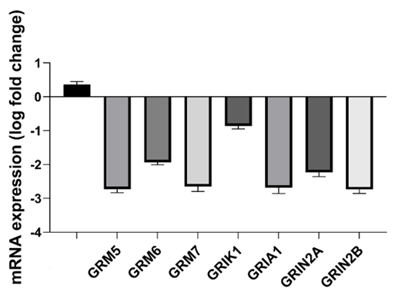
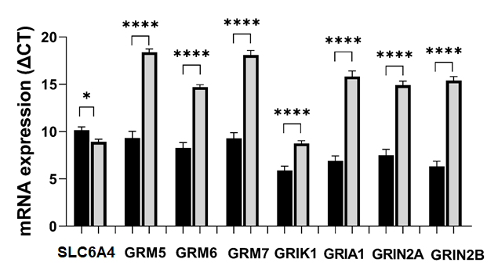
Serotonin transporter expression was increased in ADHD patients along with a reduction in the expression of the Glutamate receptor genes
Control
Case
SLC6A4
Chatterjee et al., World Journal of Pediatrics, 18:825-834, (2022)
Chatterjee et al., Scientific Reports, 12(1):18449, (2022)
Chatterjee et al., Scientific Reports, 13:19922, (2023)

Slide 35
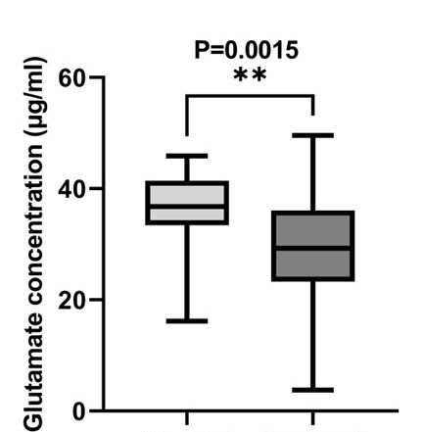
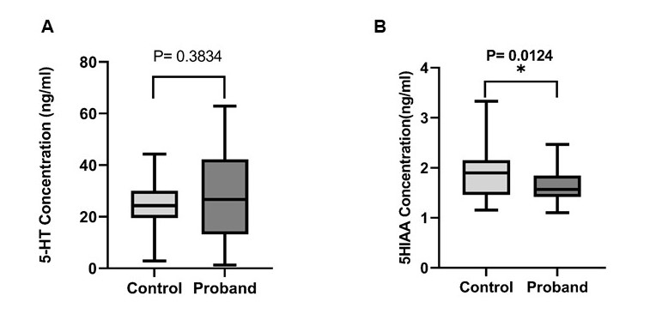
Serotonin levels didn’t show a significant difference while
Glutamate levels were significantly reduced in ADHD patients
Control Case
Control Case
Control Case
* 5-Hydroxy Indole Acetic Acid (5-HIAA) is a metabolite of Serotonin
Chatterjee et al., World Journal of Pediatrics, 18:825-834, (2022)
Chatterjee et al., Scientific Reports, 13:19922, (2023)

Slide 36
Our previous analyses in ADHD patients revealed
Lower glutamatergic signalling
Reduced dopaminergic signalling in at-risk genetic variants
Chatterjee et al., Scientific Reports, 12:18449, (2022)
Chatterjee et al., Scientific Reports, 13:19922 (2023)
Maitra et al., J Neurogenetics, 33:209, (2019)
Based on these data we hypothesized that
The hypo-dopaminergic condition could be due to lower glutamatergic signalling
Dysregulated executive function
Behavioural Impairments

Slide 37
To validate our hypothesis we have analyzed the influence of dopaminergic, GABAergic and glutamatergic systems in the etiology of ADHD

Slide 38
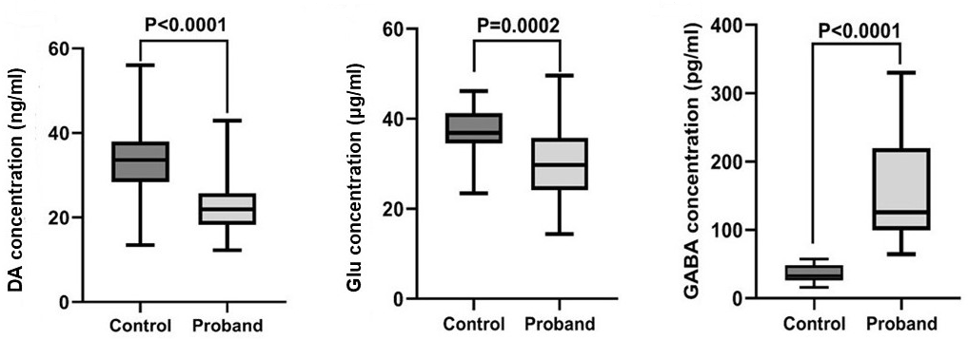
Comparative analysis revealed Lower Dopamine, Glutamate and higher GABA levels in ADHD patients

Slide 39
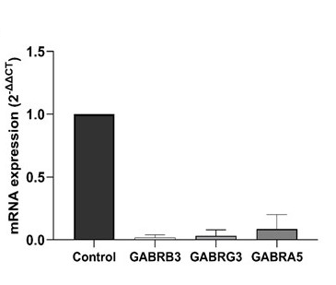
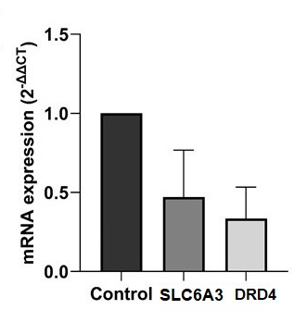
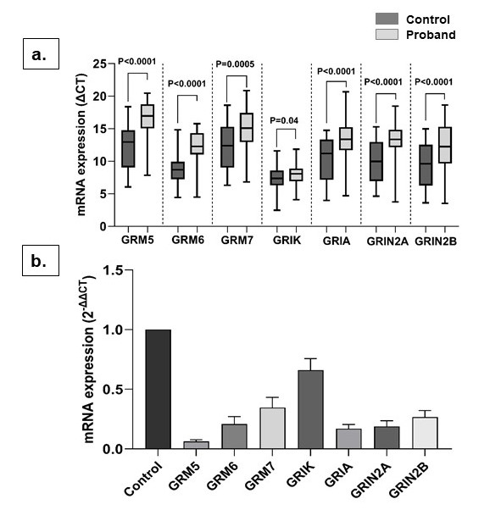
Genes encoding Dopamine transporter, Dopamine receptor, Glutamate receptors and GABA receptors were downregulated in ADHD patients
Dopamine transporter & receptor
Glutamate receptors
GABA receptors

Slide 40
Our studies confirmed an interactive influence of Dopamine, Glutamate, and GABA in ADHD
Lower expression of GABA receptor and higher levels of circulating GABA deregulates GABA-ergic signalling.
Lower glutamate levels and glutamate receptor expression leads to hypo-glutamatergic signalling
Reduced DA-ergic signalling
Loss of Reward function
Dysregulated executive function
Behavioural Impairments

Slide 41
Role of drug metabolizing enzymes in ADHD
Cytochrome P450 2D6 (CYP2D6), enzyme metabolizes drugs used for treating psychiatric disorders
Functional CYP2D6 genetic variants
Two copies of normal allele
Two copies of mutant allele
>Two copies of normal allele
Normal metabolizer
Poor metabolizer
Ultra rapid metabolizer
No adverse drug reaction caused by
usual therapeutic dose
Adverse drug reaction due to drug accumulation
Accelerated drug metabolism requiring repeated dosing

Slide 42
Patients with derived alleles of CYP2D6 showed higher ADHD trait scores
Behavioral Problem
Inattention
Hyperactivity
ADHD Index
Chatterjee et al., Drug Metabolism and Personalized Therapy, 38(1):45-56, (2022)

Slide 43
Pharmaceutical Intervention given to ADHD patients at Manovikas Kendra
For 2 months
For next 4 months
Patients <10 years, having hyperactivity, & residing in urban areas
Methylphenidate
(MPH)
0.3mg/kg body weight/day
0.6mg/kg body weight/day
Patients >10 years, with inattention, & residing in rural areas
Atomoxetine
(ATX)
0.8mg/kg body weight/day
1.2mg/kg body weight/day
Chatterjee et al., Drug Metabolism and Personalized Therapy, 38(1):45-56, (2022)
Chatterjee et al., Scientific Reports, 12(1):18449, (2022)
Chatterjee et al., Scientific Reports, 13:19922, (2023)
Notes:
ATX is not prescribed to the patient <10 years due to hepatotoxicity

Slide 44
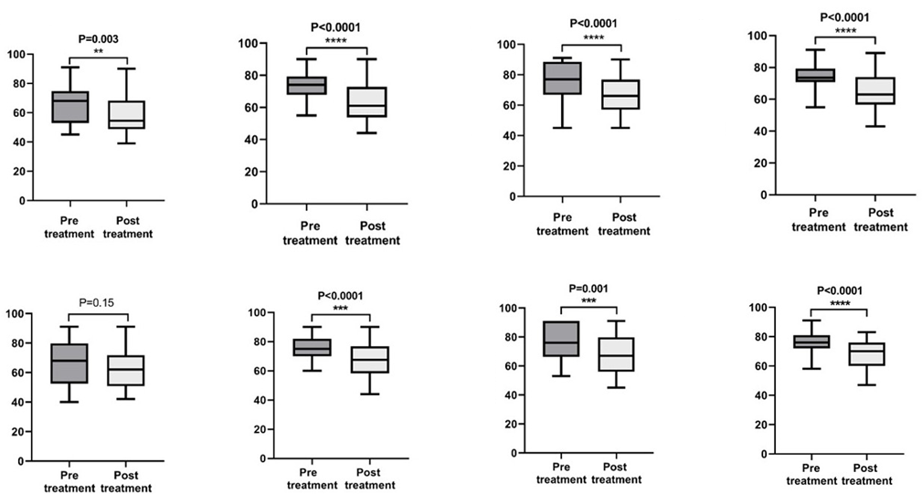
Trait scores were lower following treatment
Behavioral Problem
Inattention
Hyperactivity
ADHD Index
MPH
Trait Scores
ATX
Trait Scores
Chatterjee et al., Drug Metabolism and Personalized Therapy, 38(1):45-56, (2022)
Notes:
Both MPH & ATX treatment significantly reduce inattention, hyperactivity and ADHD Index. Behavioral problem was primarily improved by MPH treatment

Slide 45

Patients with wild-type variants respond better to MPH intervention
Chatterjee et al., Drug Metabolism and Personalized Therapy, 38(1):45-56, (2022)
Chatterjee et al., Scientific Reports, 13:19922, (2023)
Notes:
Post-treatment improvement in symptoms (improvement index) was calculated by 1-Tn/To (Tn =post-treatment CPRS score, To = initial CPRS score)

Slide 46
Our data suggests that targeted pharmacogenomics-based therapy can provide personalised solutions for ADHD & ASD patients
Genetic and neurotransmitter analyses allow psychiatrists to prescribe a suitable dosage of the appropriate drug for remediation to neurodivergent patients
We also provide Brain function therapy to these patients based on individual needs

Slide 47

Key Publications
Shom et al., (2024), Indian ASD probands with 25(OH)D and vitamin D binding protein deficiency exhibited higher severity, Scientific Reports, 10.1038/s41598-024-70188-x.
Dutta et al., (2024), Metabotropic glutamate receptor genetic variants and peripheral receptor expression affects trait scores of autistic probands, Scientific Reports, 10.1038/s41598-024-59290-2.
Saha et al., (2023), Analysis of neurotransmitters validates the importance of the dopaminergic system in autism spectrum disorder, World Journal of Pediatrics, 10.1007/s12519-023-00702-0.
Chatterjee et al., (2023), Glutamate receptor genetic variants affected peripheral glutamatergic transmission and treatment-induced improvement of Indian ADHD probands, Scientific Reports, 10.1038/s41598-023-47117-5.
Adak et al., (2023), Gamma-Aminobutyric Acid Type A Receptor Variants are Associated with Autism Spectrum Disorders, Journal of Molecular Neuroscience, 10.1007/s12031-023-02113-2.
Chatterjee et al., (2022), Post-treatment symptomatic improvement of the eastern Indian ADHD probands is influenced by CYP2D6 genetic variations, Drug Metabolism and Personalized Therapy, 10.1515/dmpt-2022-0120.
Chatterjee et al., (2022), A three-pronged analysis confirms the association of the serotoninergic system with attention deficit hyperactivity disorder, World Journal of Pediatrics, 10.1007/s12519-022-00614-5.
Saha et al., (2022), GABA Receptor SNPs and Elevated Plasma GABA Levels Affect the Severity of the Indian ASD Probands, Journal of Molecular Neuroscience, 10.1007/s12031-022-02023-9.
Saha et al., (2022), Analysis of association between components of the folate metabolic pathway and autism spectrum disorder in eastern Indian subjects, Molecular Biology Reports, 10.1007/s11033-021-06956-z.
Maitra et al., (2020), Working Memory, Impulsivity And Emotional Regulation correlates with frontal asymmetry of healthy young subjects during auditory session, Neural Network, 10.14311/NNW.2020.30.024
Chakraborti B et al., (2020), Gender-Specific Effect of 5-HT and 5-HIAA on Threshold Level of Behavioral Symptoms and Sex-Bias in Prevalence of Autism Spectrum Disorder, Frontiers in neuroscience, 10.3389/fnins.2019.01375
Dutta et al., (2011), Importance of gene variants and co-factors of folate metabolic pathway in the etiology of idiopathic intellectual disability, Nutritional Neuroscience, 10.1179/1476830511Y.0000000016.

Slide 48
Work in Progress
Relevance of Carboxylesterase 1 (CES1) gene variants in response to methylphenidate: A study on the ADHD probands- Mahasweta Chatterjee, Sharmistha Saha, Nilanjana Dutta, Kanchan Mukhopadhyay
Role of oxytocinergic system in the etiology of Autism Spectrum Disorders- Sharmistha Saha, Mahasweta Chatterjee, Nilanjana Dutta, Madhumita Mondal, Kanchan Mukhopadhyay
Role of chloride transporter and effect of polyphenol in ASD: An explorative analysis- Nilanjana Banerjee, Pallabi Adak
Heavy Metal Toxicity: Potential Risk Factor for Neurodevelopmental Disorders –Nilanjana Banerjee, Sarosh N Fatakia, Sharmistha Saha, Mahasweta Chatterjee, Pallabi Adak, Kanchan Mukhopadhyay
The effects of neurofeedback and cognitive training on behavior and brain functional networks in children with ADHD & ASD- Mahasweta Chatterjee, Sharmistha Saha, Nilanjana Dutta, Samidh S Chakraborty, Madhumita Mondal, Nilanjana Banerjee, Sarosh N Fatakia, Kanchan Mukhopadhyay
Emerging role of Non-coding RNAs in ADHD and ASD- Chinmay Saha, Nitai P Bhattacharyya, Sharmistha Saha, Mahasweta Chatterjee, Nilanjana Banerjee, Samidh S Chakraborty, Sarosh N Fatakia, Kanchan Mukhopadhyay

Slide 49
Recent trends in Autism/ ADHD research
Non-coding RNA- Post-transcriptional regulation of genes related to ASD by miRNA and lncRNA
Synaptic signaling pathway- Wnt signaling pathway, PI3K-AKT/mTOR signaling ERK/MAPK signaling.
Gut microbiota- Gut microbiota and ASD & ADHD
Epigenetic modification- DNA methylation, Histone acetylation/ Phosphorylation/ Ubiquitination/ SUMOylation
Neuroinflammation and immunology- Microbiota-gut-brain axis, adaptive immunity, neuroimmune crosstalk
Risk factors- genetic variants, environmental factors, maternal immune activation
Neuroanatomy- Abnormal brain development in cerebral cortex, striatum, amygdala, and cerebellum

Slide 50
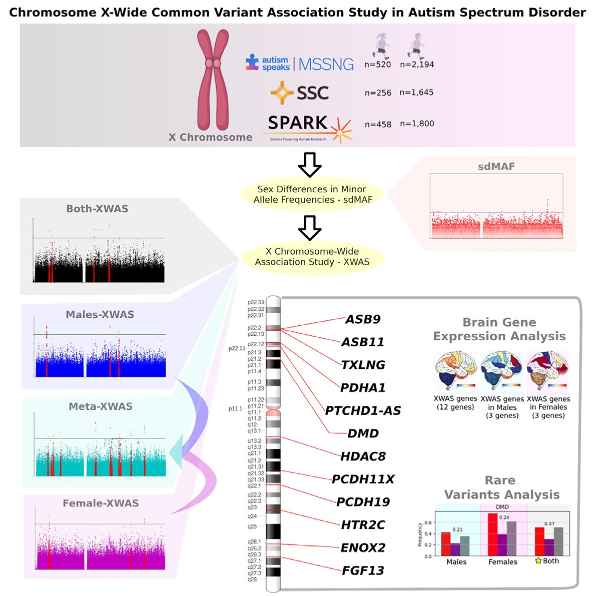
Why the Male bias?
An X-chromosome-wide association study of 6,873 individuals with autism identifies 59 variants and 17 genes (GRPR, AP1S2, DDX53, HDAC8, PCDH19, PTCHD1, PCDH11X, PTCHD1-AS, DMD, SYAP1, CNKSR2, GLRA2, OFD1, CDKL5, GPRASP2, NXF5, and SH3KBP1) associated with ASD. The findings highlight sex-linked genetic influences and provide key insights into X-linked mechanisms underlying the male bias in ASD prevalence.
Mendes et al., The American Journal of Human Genetics 112, 135–153 (2025)

